Slide 1

Unit Testing
Building Rock-Solid Software
SoftUni Team
Technical Trainers
Software University
http://softuni.bg

Slide 2
Table of Contents
What is Unit Testing?
Testing Principles
3A Pattern
Best Practices

Slide 3
Questions
sli.do #fund-common

Slide 4

What is Unit Testing
Software Used to Test Software

Slide 5
Unit Testing
A unit test is a piece of code that checks whether a piece of functionality is working as expected
Allows developers to see where (and why) errors occur
nums = [2, 15, -2, 4];
sortNums(nums);
if (nums == [-2, 2, 4, 15]) { return "Numbers are sorted!"; }
else {
return "Numbers are not sorted!";
}

Slide 6
Manual Testing
Not structured
Not repeatable
Cannot cover all of the code
Not as easy as it should be

Slide 7
Moving Away from Manual Testing
We need a structured approach that:
Allows refactoring
Reduces the cost of change
Decreases the number of defects in the code
Bonus:
Improves design

Slide 8
Automated Testing
System tests
Integration tests
Unit tests
System
Integration
Unit

Slide 9
What is AAA Testing Pattern
Organize and clarify test code by breaking down a test case into the following functional sections:
The Arrange section of a unit test initializes objects and sets the value of the data that is passed to the test case
The Act section invokes the test case with the arranged parameters
The Assert section verifies the test case behaves as expected

Slide 10
3A Pattern
{
//Arrange
array = [0, 0, 0];
//Act
array[0] = 5;
//Assert
if (array[0] == 5)
return true;
else
return false;
}
Each test should test a single behavior!

Slide 11
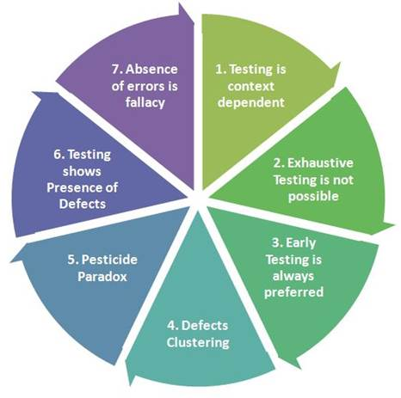
Seven Testing Principles

Slide 12
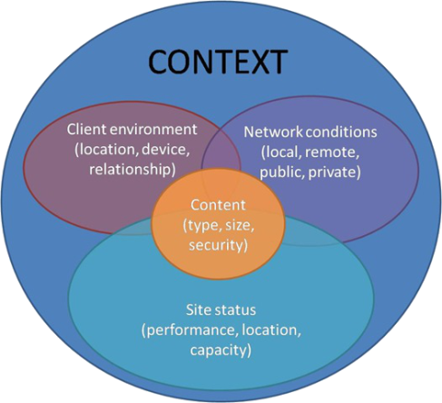
Seven Testing Principles
Testing is context dependent
Testing is done differently in different contexts
Example:
Safety-critical software is tested differently from an e-commerce site

Slide 13
Seven Testing Principles (2)
Exhaustive testing is impossible
All combinations of inputs and preconditions are usually almost an infinite number
Testing everything is not feasible
Except for trivial cases
Risk analysis and priorities should be used to focus testing efforts

Slide 14
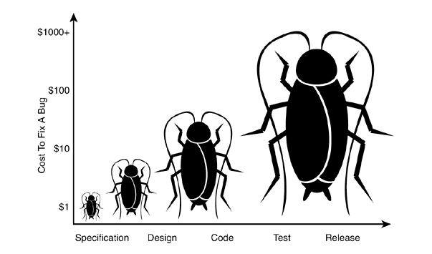
Seven Testing Principles (3)
Early testing is always preferred
Testing activities shall be started as early as possible
And shall be focused on defined objectives
The later a bug is found – the more it costs!

Slide 15
Seven Testing Principles (4)
Defect clustering
Testing effort shall be focused proportionally
To the expected and later observed defect density of modules
A small number of modules usually contain most of the defects discovered
Responsible for most of the operational failures
Notes:
In your opinion which operation is most likely to cause your Operation system to fail?
- Opening Microsoft Word
- Open IE
- Opening 10 different application all at the same time

Slide 16
Seven Testing Principles (5)
Pesticide paradox
Same tests repeated over and over again tend to lose their effectiveness
Previously undetected defects remain undiscovered
New and modified test cases should be developed

Slide 17
Seven Testing Principles (6)
Testing shows the presence of defects
Testing can show that defects are present
Cannot prove that there are no defects
Appropriate testing reduces the probability for defects

Slide 18
Seven Testing Principles (7)
Absence-of-errors fallacy
Finding and fixing defects itself does not help in these cases:
The system built is unusable
Does not fulfill the users’ needs and expectations

Slide 19

Unit Testing Best Practices
How to Write Good Tests

Slide 20
Magic Numbers
Avoid using magic numbers
//Arrange
array = [0, 0, 0];
index = 0;
value = 5;
//Act
array[index] = value;
//Assert
if (array[index] == value)
return true;
else
return false;
//Arrange
array = [0, 0, 0];
//Act
array[0] = 5;
//Assert
if (array[0] == 5)
return true;
else
return false;

Slide 21
Naming Tests
Test names
Should use business domain terminology
Should be descriptive and readable

Slide 22
Code Coverage
You should test every possible outcome (valid or invalid) of your code
array = [0, 0, 0];
index = 5;
value = 3;
array[index] = value;
if (index < 0)
"Negative index!"
if (index >= array.length)
"Index out of boundaries!"
if (array[index] != value)
"Value incorrect!"

Slide 23

Summary
…
…
…
Unit Testing helps us build solid code
Structure your unit tests - 3A Pattern
Follow the 7 testing principles
Avoid magic numbers
Cover all outcomes of your code

Slide 24
https://softuni.bg/courses/programming-fundamentals

Slide 25












SoftUni Diamond Partners

Slide 26




SoftUni Organizational Partners

Slide 27




Trainings @ Software University (SoftUni)
Software University – High-Quality Education and Employment Opportunities
softuni.bg
Software University Foundation
http://softuni.foundation/
Software University @ Facebook
facebook.com/SoftwareUniversity
Software University Forums
forum.softuni.bg

Slide 28

License
This course (slides, examples, demos, videos, homework, etc.) is licensed under the "Creative Commons Attribution-NonCommercial-ShareAlike 4.0 International" license

